Slide 1
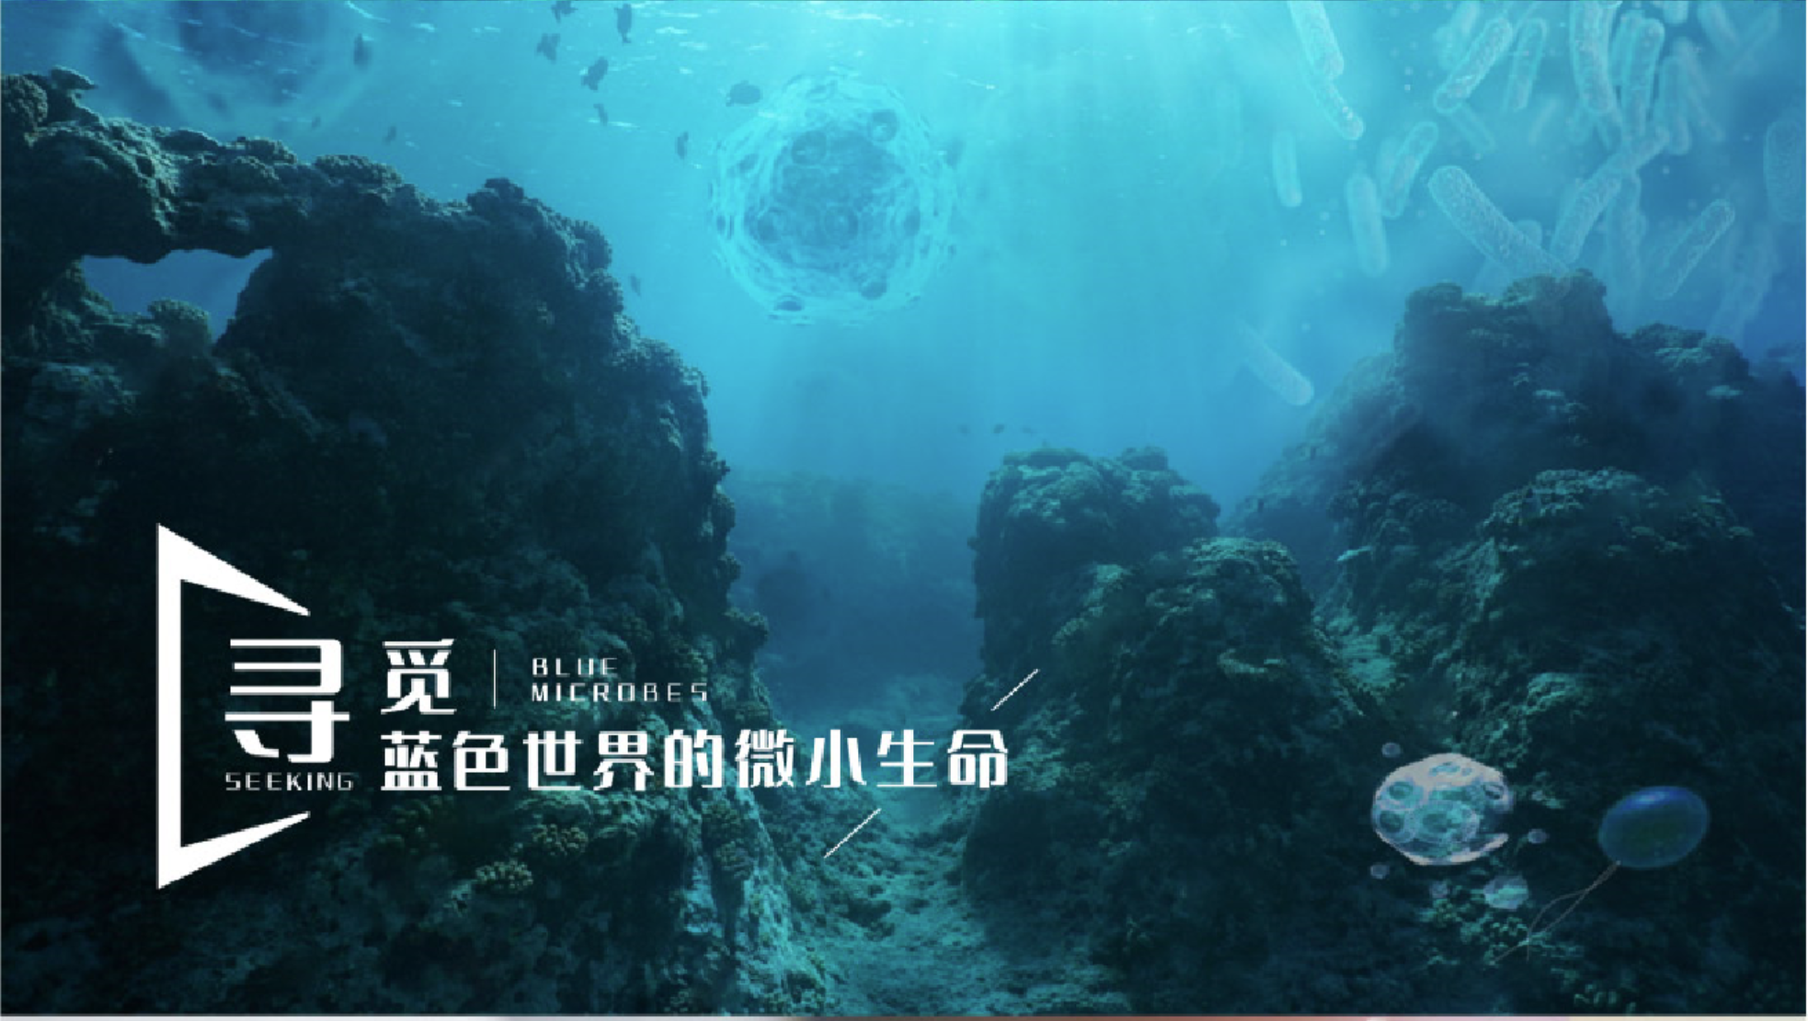
海洋微生物学及实验
2024-2025学年 秋第一周

Slide 2
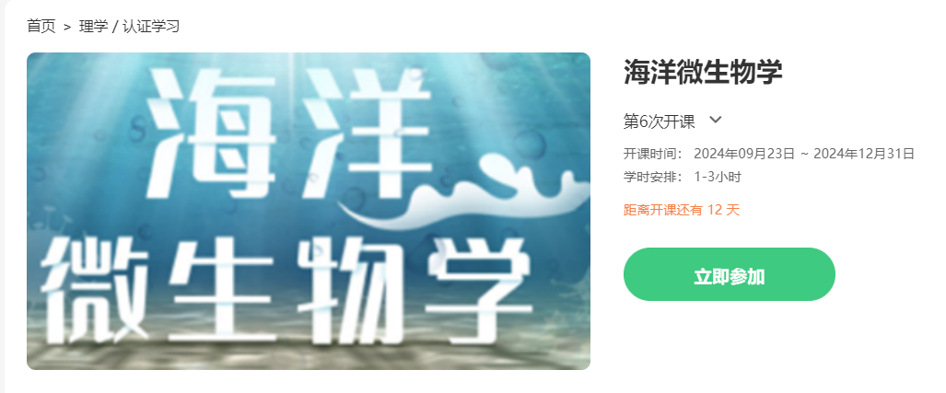

成绩构成
9月23日开课
考核环节 | 分值 | 考核/评价细则
平时成绩 | 10 | 考勤、MOOC、学在浙大的讨论、测验等，按总成绩的10%计入成绩。
期中考试 | 20 | 考核Lecture1-10的教学内容掌握情况，以卷面成绩的20%计入课程总成绩。
期末考试 | 30 | 全部教学内容，以卷面成绩的30%计入课程总成绩。
课程实验 | 40 | 16个线下实验，每个实验过程与完成情况： 每个实验1分；共16分
 |  | 虚拟仿真实验操作：在规定时间期限内完成， 检查完成情况，满分4分。
 |  | 实验报告：16个标准规范要求的线下实验报告， 每个5分，按总分的25%计入总成绩。
注： 期末考试成绩低于50%分数，总评不能及格； 实验成绩低于40分的60%，总评不能及格。

Slide 3
课程PPT、通知主要在钉钉发布
学在浙大：讨论、课程PPT等资源
组号（共19人）
A（2人）
B（2人）
C（2人）
D（2人）
E（2人）
F（3人）
G（3人）
H（3人）
实验课教师：王品美
wangpinmei@zju.edu.cn
助教：陈溢辉
每周实验结束后，每周一个小组协助助教打扫卫生、收尾

Slide 4
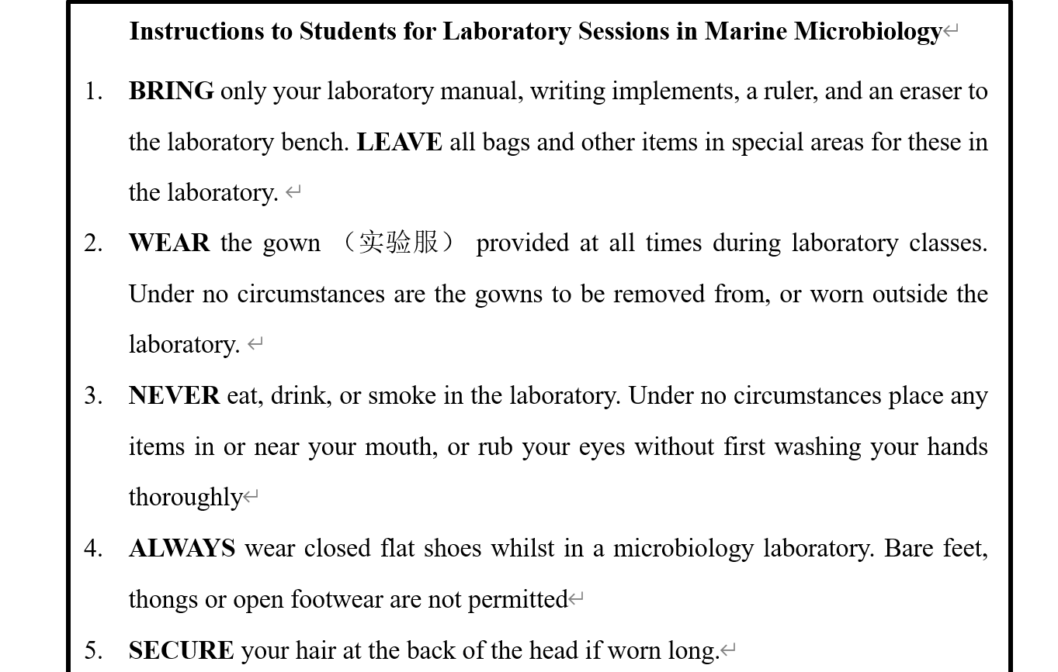
实验安全注意事项

Slide 5
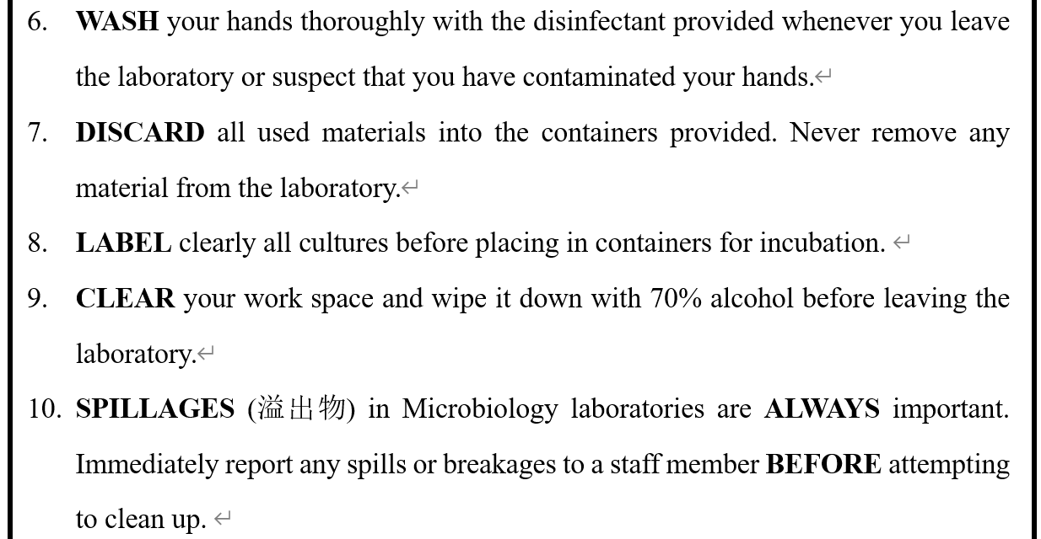
***Notify your teacher or TA of any INJURIES (受伤) ; there is a medical first aid kit in the hallway.

Slide 6
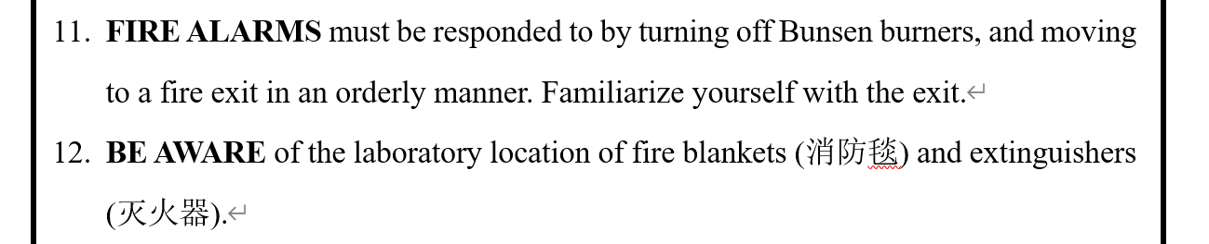

Slide 7
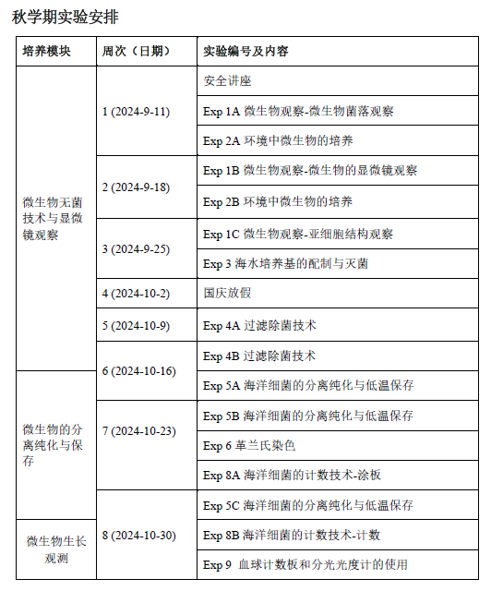
实验手册的介绍
实验报告
按模板，电子版提交至邮箱 wangpinmei@zju.edu.cn
每个实验报告满分5分
秋学期实验安排

Slide 8
EXPERIMENT 1: Observing microorganism
微生物的观察
INTRODUCTION：
Microorganisms grow tremendously fast when supplied with an abundance of nutrients. Different types of microorganism will produce different-looking colonies (菌落), some colonies may be colored, some colonies are circular in shape, and others are irregular. The characteristics of a colony (shape, size, pigmentation, etc.) are termed the colony morphology. Colony morphology is a way scientists can identify microorganisms.
Although bacterial (细菌的) and fungal (真菌的) colonies have many characteristics and some can be rare, there are a few basic characteristics that you can identify for all colonies, such as form, elevation, margin, surface, opacity, and color (Appendix A).
For bacterium/bacteria, each distinct circular colony should represent an individual bacterial cell or group that has divided repeatedly. Most bacterial colonies appear white, cream, or yellow in color, and fairly circular in shape.
Fungus/fungi-Yeast (酵母) colonies generally look similar to bacterial colonies. Molds are actually fungi, and they often appear whitish grey, with fuzzy edges.

Slide 9
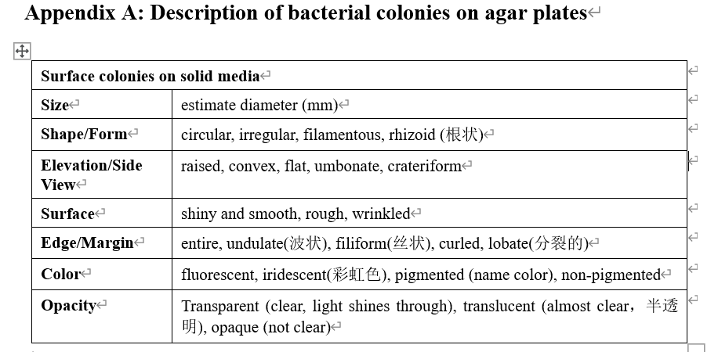

Slide 10
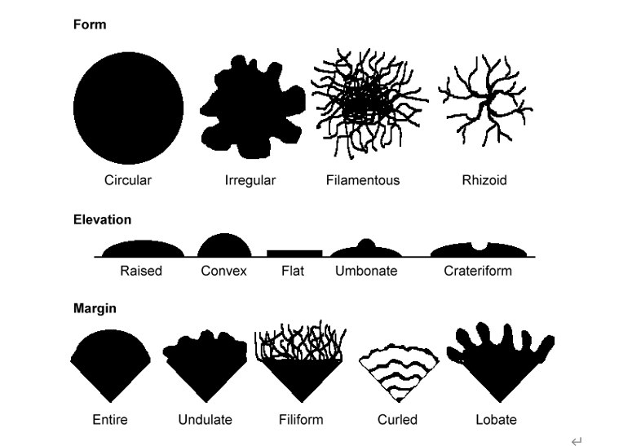
形状
高度
隆起 凸起 扁平 中间凸起 环形；火山口状
边缘
全缘 波状 丝状 卷曲 瓣状；裂片状

Slide 11
OBJECTIVES
At the end of this experiment, you should:
Be able to describe of microorganism on plates （Exp.1A）
Be familiar with the procedures for setting up an optical microscope for bright-field microscopy
Have a good working knowledge of the examination of microorganisms by bright-field microscopy

Slide 12
EXP 1A
Plates of microorganisms （微生物平板）
A. Escherichia coli （大肠杆菌）
B. Bacillus subtilis （枯草芽孢杆菌）
C. Staphylococcus epidermidis （表皮葡萄球菌）
D. Staphylococcus aureus （金黄色葡萄球菌）
E. Pseudomonas aeruginosa （铜绿假单胞菌）
F. Actinobacillus （放线菌）
G. Saccharomyces cerevisiae （酿酒酵母）
H. Aspergillus （曲霉）
细菌（原核）
Bacterium/bacteria
真菌（真核）
Fungus/fungi

Slide 13
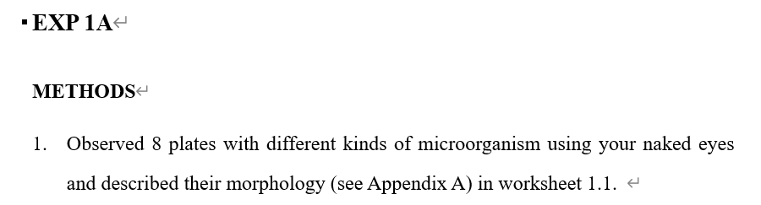
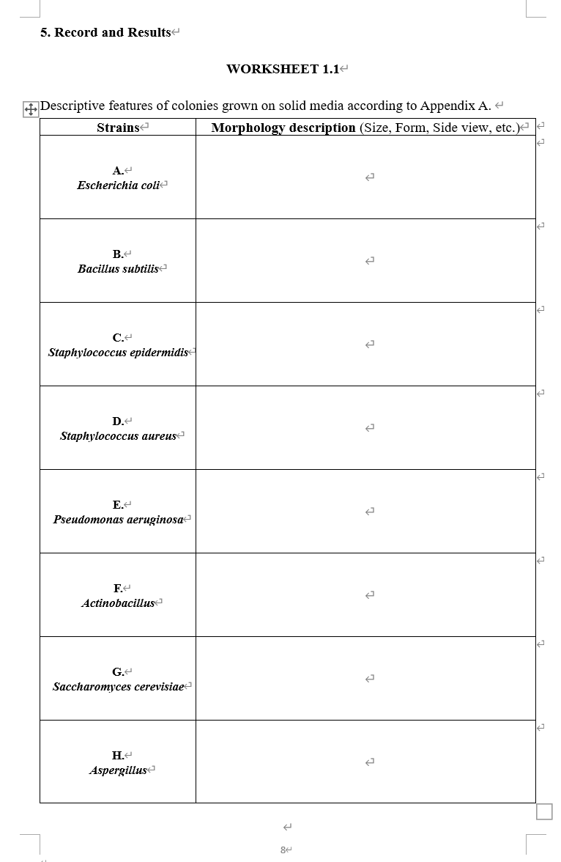
Page 8

Slide 14
EXPERIMENT 2: Contamination and aseptic techniques 污染与无菌技术
INTRODUCTION
Contamination by microorganisms is a major problem in lab. Bacteria, mycoplasma (支原体), yeast, and fungal spores (孢子) may be introduced via the operator, the atmosphere, work surfaces, solutions and many other sources.
Aseptic technique (无菌技术) is a combination of procedures designed to reduce the probability of infection.
Proper aseptic techniques：
Autoclave (高压灭菌) or sterile filter (过滤除菌，Exp 4)
70% ethanol (EtOH)
Ultraviolet sterilization (UV) (紫外灭菌)
Ethylene oxide sterilization (环氧乙烷灭菌)

Slide 15
General Rules of aseptic technique in lab:
Use sterile tips, reagents and media for work to keep them that way. (Autoclave or sterile filter as appropriate; do not reuse tips; clean the outside of reagent bottles with 70% ethanol (EtOH) when necessary.)
Wear gloves–but note that these are to protect you, and are not inherently clean!
Keep the work surface clean-clean with 70% EtOH and keep the work area clear enough to allow work without reaching over an item and preventing inadvertent brushing of a sterile tip against another object.
Keep bottles, flasks and tubes covered as much as possible.
Clean bench (实验操作台) surface and your glove with 70% EtOH often (s), and dry them with paper towels.

Slide 16
Most cell culture work is done in a laminar flow hood (超净台).
Start-up In The Hood
Working In The Hood
When You Are Finished

Slide 17
OBJECTIVES
At the end of this experiment, you should:
Know that microorganisms are ubiquitous
Know why aseptic technique is essential in the laboratory
Know how to use a laminar flow hood
Be able to describe bacterial colonies on the surface of agar media

Slide 18
Exp.2A
EQUIPMENTS and MATERIALS
A laminar flow hood
Incubator 培养箱
Parafilm 封口膜
4 × LB (Luria-Bertani) agar plates (Appendix D)
Sterile cotton swabs 无菌棉签
70% EtOH in a spray bottle 装有70%乙醇的喷壶

Slide 19
Exp.2A (Page15)
Method
Label all plates on the base (agar side) around the edge in small letters. Divide a LB plate into 3 sections. (Fig.2.1)
Inoculate each section of the plate with the appropriate swab.
Divide another LB plate into 2 sections.
Open the 3rd LB plate opened in the hood after UV for 20 mins. (at least 30 mins)
Open the 4th LB plate and one blood plate near to window. (at least 30 mins)

